Slide 1
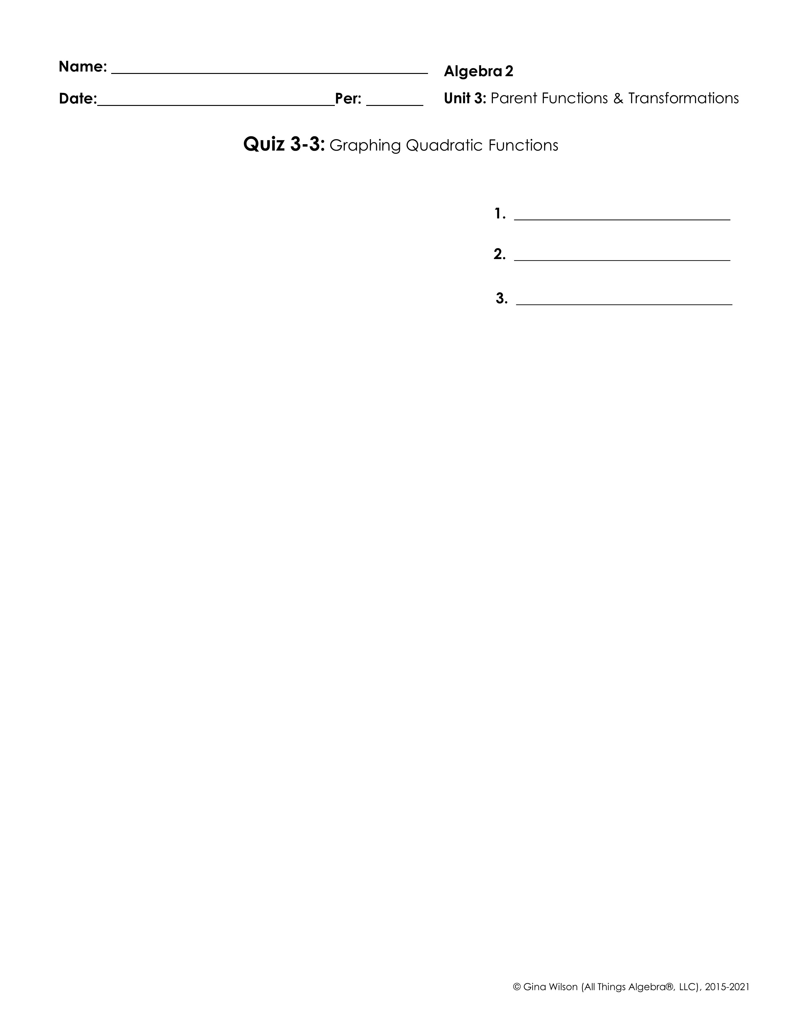
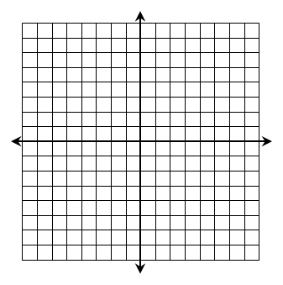
Identify the following forms in respect to quadratic functions.
1. Parent Function
2. Standard Form
3. Vertex Form
Give the axis of symmetry, vertex, then graph the function. Give the domain and range.
4.
x | f (x)
Axis of Symmetry: __________________
Vertex: ___________________
Domain: ________________________
Range: __________________________
5.
x | f (x)
Axis of Symmetry: __________________
Vertex: ___________________
Domain: ________________________
Range: __________________________
6.
x | f (x)
Axis of Symmetry: __________________
Vertex: ___________________
Domain: ________________________
Range: __________________________

Slide 2

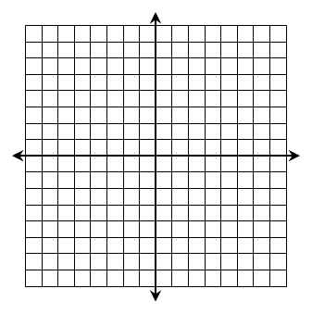
7.
x | f (x)
Axis of Symmetry: __________________
Vertex: ___________________
Domain: ________________________
Range: __________________________
8.
x | f (x)
Axis of Symmetry: __________________
Vertex: ___________________
Domain: ________________________
Range: __________________________
9. The parent function of a quadratic equation is vertically stretched by a factor of 2, then translated 5 units right and 1 unit down. Write the equation of the new function in vertex form.
Write each function in vertex form.
10.
11.
12.

